Slide 1

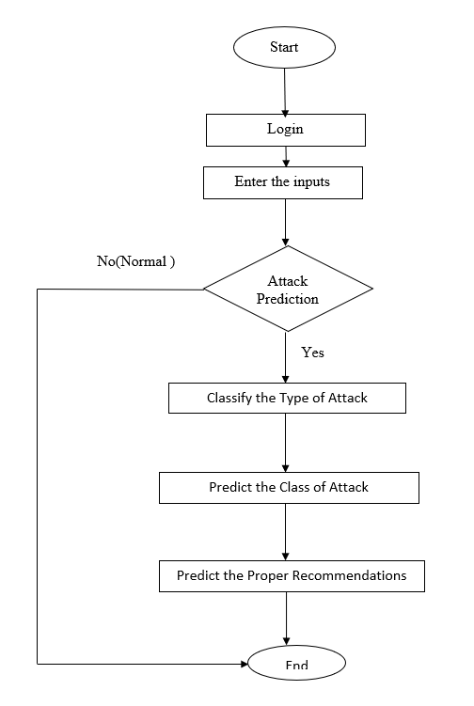

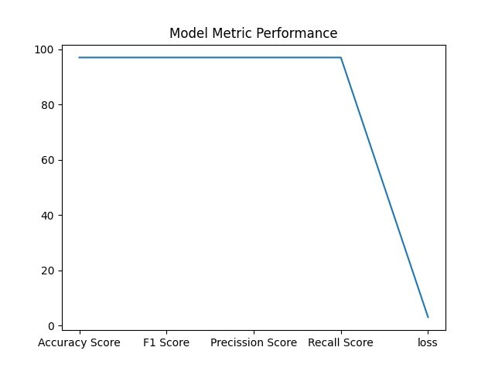
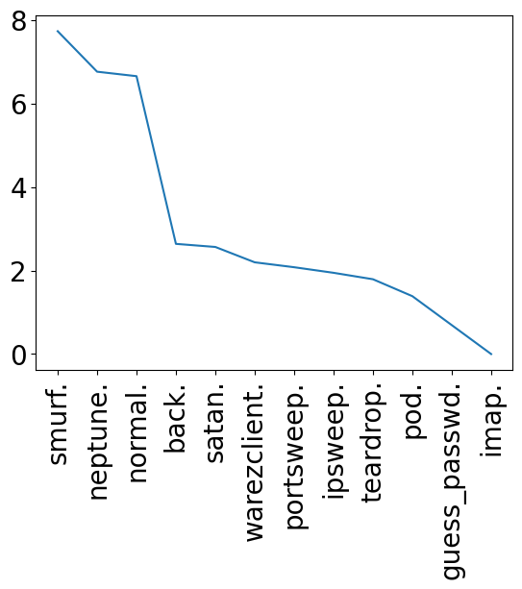
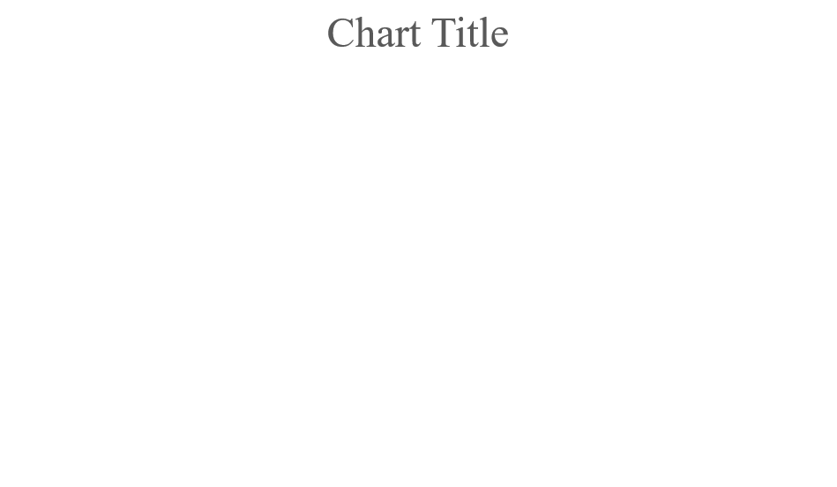
Prediction of Intrusion Attacks Using ML Approach
Guided by: Prof. Dr.E.L.N. Kiran Kumar, Associate Prof, School of CS and AI.
M.Saiganesh-2003A53011
M.Koushik-2003A53010
P.Shashi Preetham-2003A53001
T.Aravind-2003A53014
Dataset:KDDCUP’99
Data-Preprocessing
Flow Chart
Results
We have taken the dataset from KDDCUP’99 year from which we have taken this type of rows they are: src_bytes , dst_bytes , is_host_login , is_guest_login ,srv_diff_host_rate , diff_srv_rate , protocol_type , service , flag , attack_type, severity, recommendation.
For Prediction we have converted some values in the data set into integer type we can easily preprocess the data .
From the original dataset we has taken 4000 rows for testing and training by these we can easily preprocess the dataset .
We add new column named “Recommendation” by these we can know which type of attack is happened.
The rows which we have considered for the prediction are some categorical data, those we have converted into numerical values. The type of data having highest frequency considered as First priority ,continued it accordingly.
Based On the Inputs ,we can predict the output ,provide Recommendations ,precautions.,
we can see the Model Metric Performance such as Precision score ,loss and other as in above figure.
References
http://bit.ly/3Mkayb9
https://bit.ly/3Sjk426
https://bit.ly/3FxJlOD
https://bit.ly/497Msu1
https://bit.ly/3Mkw67L
Conclusion
An attempt has been made to check the performance of the machine learning classifiers namely Support Vector Machine, Random Forest, Decision Tree, Logistic Regression and Linear Regression and Gaussian Naive Bayes are compared for an intrusion detection. These algorithms are tested with the KDD data-set. From the observed results it can be concluded that the Logistic Regression and output performs better other classifiers for the considered data-set and parameters.
It has the accuracy of 97%. The work can be extended by considering the classifiers for multiclass classification and considering only the important attributes for the intrusion detection.
We want analyze latest data and see how model perform.
Majority of cyber physical attacks reported are of type DOS Attacks(Neptune,Smurf).
Suggest possible recommendations and remedies for the cyber attacks.
Models Applied
Random Forest
Support Vector Machine
Linear Regression
Logistic Regression
Decision Tree
Gaussian Naïve Bayes

